Slide 3
USBC says:
We're for bowling. Full stop. Everything we do, we do to ensure a future for the sport. We create and uphold the rules to maximize safety and fair play. We inspect and certify the lanes, the balls, the pins, and the products that ensure an optimal experience for the greatest number of players. We provide training, scholarships, and support so that anyone who wants to excel at bowling has the opportunity. We cover the sport from every angle on Bowl/TV, in print and online offering insight and visibility into how the game is played. And we make the thrill of competition possible, to the tune of 14,000 tournaments each year, certifying scores and preserving every certified bowler's place in history for generations to came. What we do at USBC isn't easy, but it's very simple: Every day, in every way, we champion players and fair play to ensure a Future for the Sport. And certified bowlers make it possible.

Slide 5
https://4485190.fs1.hubspotusercontent-na1.net/hub/4485190/hubfs/custom-video-thumbnails/2023%20USBCWICDiTornSquare-thumb.jpeg?length=1920

Slide 6
Why Do You Certify?

Slide 7
OFFICER DUTIES
1. Training video.
2. Meet with the center regarding the league contract. Click here for negotiating tips.
3. Meeting tips:
  a. prepare an agenda
4. Appoint committees:
  a. Prize committee (required)
  b. Audit committee information (required)
  c. Other committees as needed
5. Ensure the league account is opened in the name of the league AND that monthly statements come to you, so you may verify the league account.
PRESIDENT
ALL INFORMATION CAN BE FOUND AT
Rules Extra - July2023_Edition 1

Slide 8
OFFICER DUTIES
1. Fill in for the president when not available.
2. See info under President (above) for more information about the president’s duties.
VICE PRESIDENT
ALL INFORMATION CAN BE FOUND AT
Rules Extra - July2023_Edition 1

Slide 9
OFFICER DUTIES
Get league information from the local association
Ensure every bowler:
  a. Completes a membership application
  b. Pays fees or shows receipt for membership fees already paid
Certify the league as soon as possible, but no later than 30 days after the first week
Update the league rules and pass out to the team captains
Post and/or pass out a league schedule
Update standings and pass out weekly recap sheets
Send in final averages as requested by the local association
Give all team captiams a financial statement and prize fund at end of season.
***As the League Secretary, you have an integral role in the organization of the league for the upcoming season. Actions you should take to help ensure that the status of the league is up to date.
SECRETARY
ALL INFORMATION CAN BE FOUND AT
Rules Extra - July2023_Edition 2

Slide 10
This checklist is a quick review of the league’s operational duties. The details of each officer’s duties can be found in the Playing Rules book and in the following pages of this manual.
The basics of getting your league up and rolling…
Have a meeting to adopt rules before the first session of bowling.
Establish the league account with two signatures for withdrawals and statements sent to the president.
Post a league schedule in center or distribute to each team captain.
Have all bowlers complete membership applications and pay fees in accordance with USBC Rule 101.
Send completed USBC league application and fees to your local association(s) within 30 days from the start of the schedule.
Adopt a prize/awards list within five (5) weeks of the start of the schedule.
If your league includes bowlers under age 18, discuss Youth Membership Eligibility Rule 400 with league members.

Slide 11
If your adult/youth league includes individuals under the age 18:
  A Consent Form must be completed .
  Officers must be Registered Volunteers (SafeSport Trained and a background screening through NCSI).
  All participants 18 and older, must complete SafeSport Training prior to the next league session.
The basics of keeping your league rolling…
Post or distribute current standing sheet. You can also upload the standing sheet on BOWL.com.
Distribute recap sheets and pay envelopes.
Collect all fees and pay bowling center fees.
Collect recap sheets and calculate the league records.
Deposit money into the league account within seven days.
Check if any awards were earned and process within 20 days of the score bowled. A complete list of USBC awards can be found on BOWL.com.
Have new bowlers complete membership applications and pay fees in accordance with USBC Rule 101.
President or youth league supervisor must verify league account balance monthly.

Slide 12
Sample Adult League Rules
NOTE: The following is a set of league rules, which may be adopted by completing the blanks and providing copies to each team. Other options may be available as provided in the rules outlined in Chapter 4 of the USBC Playing Rules book. Other rules may be added but cannot in any way conflict with USBC Rules.
The League will bowl on (day of week) at am/ pm at
(name of bowling center). The league will have a scheduled starting date of
and a scheduled ending date of and will participate for a total of weeks. The league will not bowl on the following dates: .
OPTION: The schedule will be divided into (halves, thirds, quarters). If there are an unequal number of weeks, the extra week will be placed in the last segment.

Slide 13
League Committees
Required Committees
Audit Committee
Checks the treasurer’s or Youth league official’s records at specified times to verify incomes, expenditures and balances. The committee ensures the league’s funds have been deposited and disbursed as directed, records have been accurately and completely kept, and expenses have been paid. Also can be tasked with auditing league records, averages and position standings. USBC has developed the audit committee worksheet and instructions to aid the committee in its task.
Prize/Award Committee
Develops and submits for consideration one or more prize/awards lists within five (5) weeks of the start of the schedule. They should contact the treasurer or Youth league official for an estimated budget or list of estimated expenses to work from and consider any league rules that effect the distribution of prizes.

Slide 14
Employee Identification Number
Many financial institutions require an Employee Identification Number (EIN) to open an account for the league. Officers do not have to fill out the form every year if the league continues.
The SS-4 Form must be completed to receive an Employee Identification Number (EIN). The SS-4 Form is available at your IRS office or online at irs.gov. An application may be completed electronically and the league will be assigned a number upon completion.
Follow these steps to apply for an EIN electronically:
Go to irs.gov
Go to the File tab at the top of the page
Click Business & Self Em ployed
Click Employer ID Numbers

Slide 15
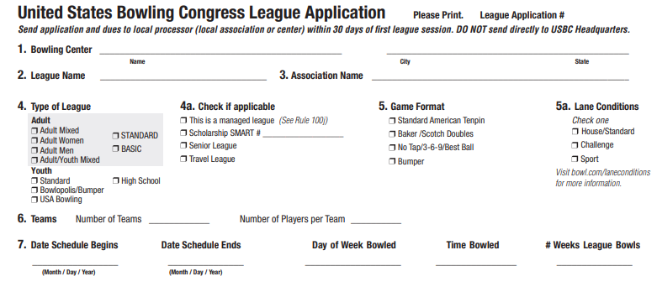
League Application
FILL OUT
APPLICATION
COMPLETLY

Slide 16
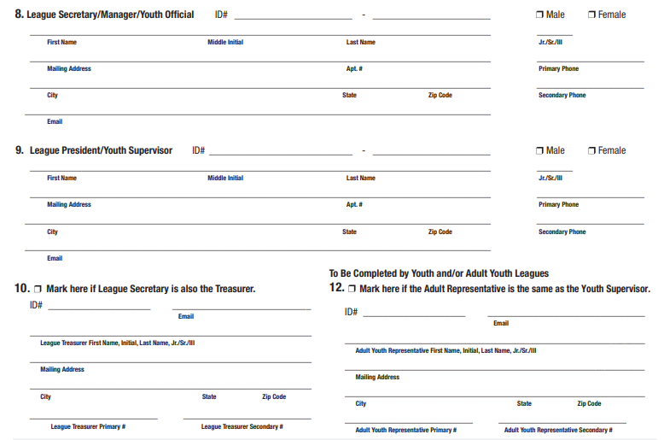

Slide 17
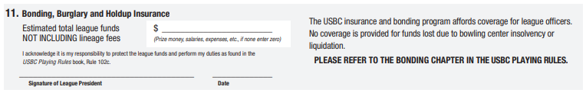
Is it really that important to list our total prize fund on the league certification application?
Yes, unless the total prize fund amount has been listed, the maximum amount of league prize money may not be covered under the USBC bonding policy.
***The president also may be liable for suspension from USBC membership for failing to make the monthly verification

Slide 18
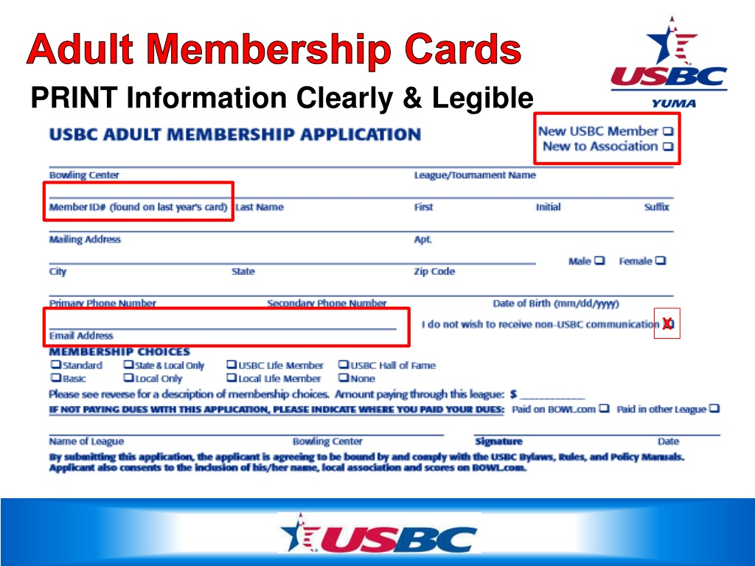


Slide 19
HOT TOPICS
MEMBERSHIP DUES:
$ 9.00 LOCAL DUES (Same as last year)
$ 2.00 STATE DUES (Same as last year)
$15.00 NATIONAL DUES
$26.00 TOTAL
ALL BOWLERS CAN BUY CARDS ONLINE THROUGH BOWL.COM

Slide 20
HOT TOPICS
GENERAL PLAYING RULE CHANGES 23-24
Rule 4f – Two-Handed Techniques (New Rule) Rule clarifies the difference between a two-handed delivery and a two-handed approach
Rule 6a – Legal Pinfall Definition of Legal Pinfall expanded to reflect string pinsetters
Rule 7c – Replacement Definition of Broken Pin expanded to reflect string pinsetters
Rule 19 - String Pin Bowling (New Rule) New rule adopted to reflect USBC certification of String Pin Bowling
TOURNAMENT RULE CHANGES
Rule 306 Removed the limitations on the entry fees for All-Events in YOUTH competition only

Slide 21
INCLUDED IN YOUR PACKET
USBC League Cards – named and blank
USBC Awards Form
Tournaments Schedule: Please announce at each league session.
Awards word doc
Rule changes
USBC RuleBook
NUUSBCA Yearbook
CDE software awards
AVAILABLE ON THE WEBSITE: FORMS
PLEASE UPDATE ANNUAL MEETING DATE ON SCHEDULE TO SATURDAY APRIL 6TH.

Slide 22
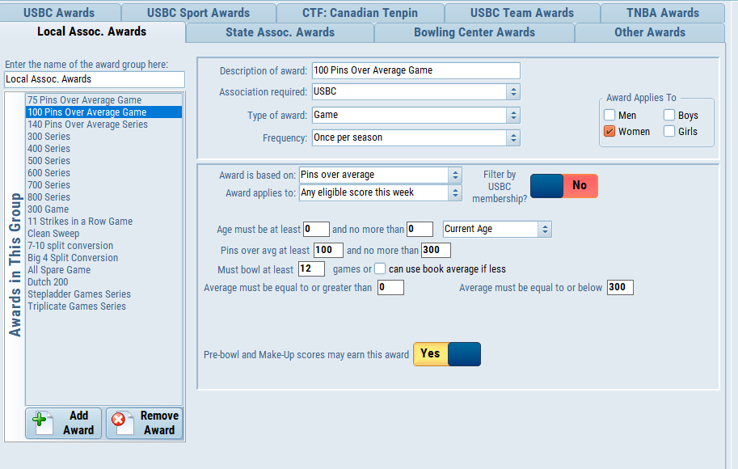
CDE Software
Awards
Setup

Slide 23
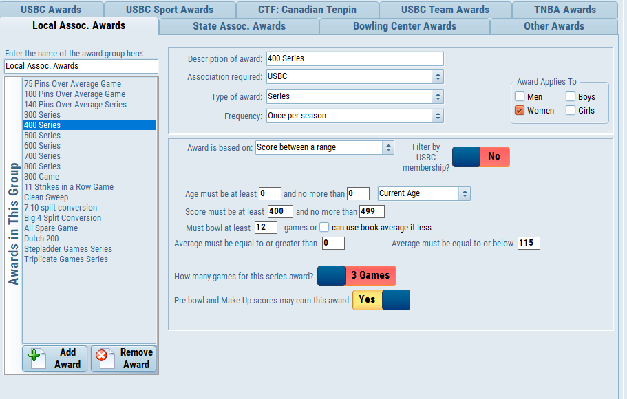

Slide 24
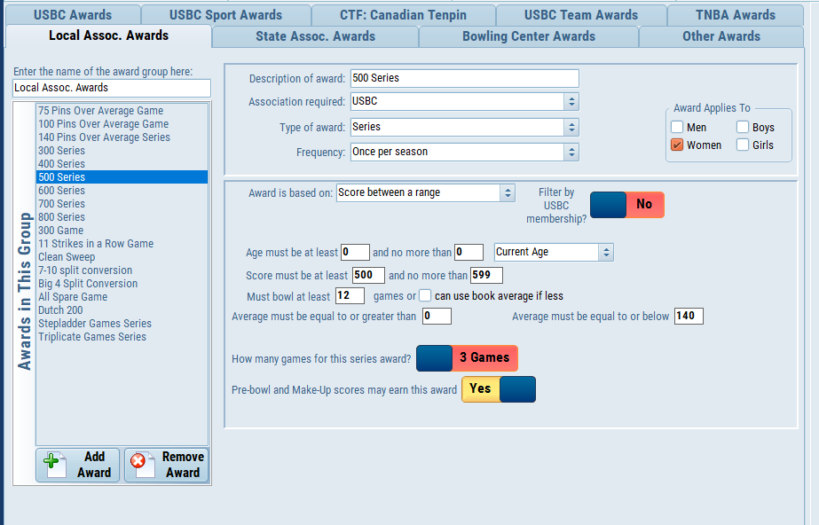

Slide 25
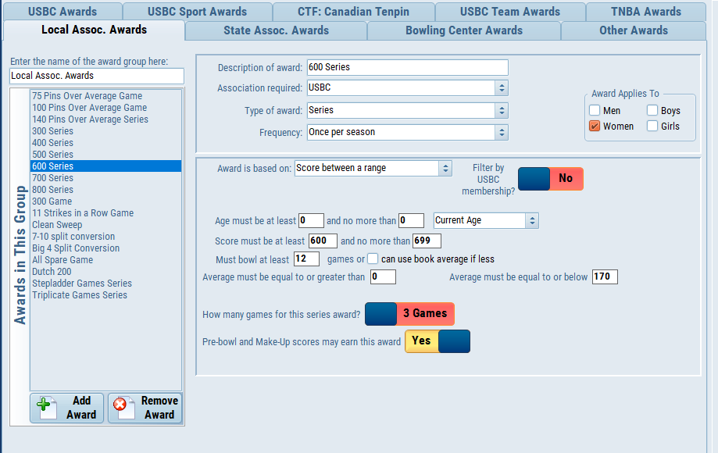

Slide 26
Other Set Up Options
Set up all information before start of 1st league session. (may take some time but worth it in the end)
Complete each tab carefully with league rules in hand.
Turn off TNBA Awards
Only Awards needed are Local and USBC

Slide 27

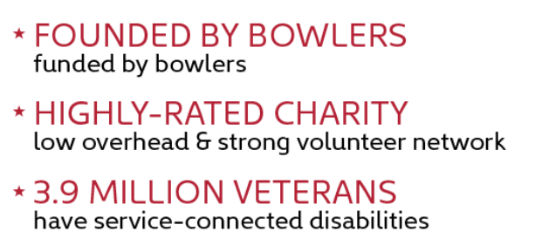

Slide 28


ANY QUESTION OR COMMENTS?
This Photo by Unknown Author is licensed under CC BY
This Photo by Unknown Author is licensed under CC BY-NC

